Slide 1


Is there still no alternative?
4th International Degrowth Conference, Leipzig, 2-6 September 2014
Self-management under a degrowth perspective: a comparative approach between two case studies in France (Fralib) and Greece (VioMe)
Katerina Apostolidi

Slide 2
Research questions
How feasible / sustainable such initiatives of self-management are?
What are the obstacles and challenges they face?
Could they be considered as an aspect of the degrowth paradigm?

Slide 3

The case of Fralib (France)
Background
Founded in 1977 by Unilever => merging of 2 subsidiaries Lipton tea (Le Havre) and The Elephant tea (Marseille)
1990-2000: period of supervised sovereignty => Fralib produces and commercialises its own wide portfolio of products. Turnover (1999): 286 million euros & profit:15 million euros
2001-2007: period of limited function => Centralisation processes to Unilever France (limited product portfolio) for cost reduction and quality degradation.
Turnover (2005): 58 million euros & profit: 7 million euros
2007-2010: period of reduced function => “faconnage” activity, Products delivered in cost-plus pricing to USCC (Unilever Supply Chain Company).
Turnover (2010): 23 million euros & profit 4 million euros)

Slide 4
The case of Fralib (France)
The workers’ struggle
Number of employees: 300 in 2003 – 182 in 2010
Sept. 2010: Unilever announces the closure of the Fralib factory in Marseille to move production to Poland
2011: Unilever fires the workers – Workers Assembly decision (98%): factory occupation claiming back the the brand and means of production
From 2011 to 2013:
consecutive juridical procedures => In 2 years Unilever proposes 3 different social plans, all denounced by workers and finally not accepted by French courts. Workers are fired and rehired 3 times.
Unilever proposes(in private negotiations) 90.000 euros to each worker in order to quit the struggle => 103 workers continue the struggle
Negotiations with Ministers, local authorities and Unilever => Unilever cedes the territories and the machines to the local authorities which in turn transfer them to the workers

Slide 5
The case of Fralib (France)
The workers’ project:
Creation of a cooperative
Return to the natural aromatisation process
Herb provision from local organic producers through direct sales networks
State financial support
Political engagement for the implementation of a solid legal framework
Transfer of the historic marseillaise brand of Thé Elephant tea to the workers’ property
Subcontraction of the commercialisation process to Univeler for 5 years
Financial participation of Unilever to the project (revitalization and training)
Project’s success is based on:
Unilever’s engagement => subcontraction, training costs, brand transfer
State’s engagement => subsidies and bank guarantees, legal framework
Workers’ engagement => creation of a cooperative (SCOP), production of high quality products

Slide 6
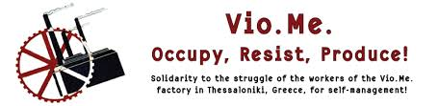
The case of VioMe (Greece)
Background
Founded in 1982 by Philkeram-Johnson, a producer of ceramic tiles -once of the biggest tile producers in Europe-, bankrupt in 2010
VioMe was specialised in the production and commercialisation of complementary products of high quality (adhesives, mortars, coatings) certified with the ISO 9001 norm
2008-2009: The mother company faces severe financial problems due to huge investments during a period of crisis
VioMe, was indebted and abandoned by owners, production and payments ceased

Slide 7
The case of VioMe (Greece)
The worker’s struggle
Consecutive strikes and employment retention for a year
The 80 workers of VioMe, decide almost unanimously (by 97%) to claim back the factory under self-management and develop their own project
Occupation of the factory and machines are put into operation
Production of low-cost, biological cleaning products
Strong bonds with citizen initiatives & social movements in Greece and abroad
Very active open solidarity initiatives to VioMe in Thessaloniki & Athens
International interest by social movements & support form personalities such as Naomi Klein, David Graeber, John Hallaway, Giorgio Agamben, etc
Building bonds with other projects of self-management around the globe (Argentina, France, Bulgaria, Romania, Mexico etc)
Wide-spread communication of the project & crowdfunding campaing
Products diffused through solidarity networks

Slide 8
The case of VioMe (Greece)
The workers’ project:
Preparation of a legal framework that will allow the appropriation of abandoned factories by workers
Cancellation of the financial obligations of VioMe to the state
Ownership of VioMe shares without the assumption of its debt, as VioMe itself has not declared bankruptcy
Funding for the re-operation of the factory through the National Employment Agency (OAED ) and the National Strategic Reference Framework (ESPA)
Restitution of the amount lent to the mother company
Elaboration of a solid business plan accruing 66 working posts
Creation of a cooperative of workers for the operation and management of the plant

Slide 9
Comparison
Similarities:
Struggling against the drawbacks of capitalist structure
High degree of motivation and determination to lead the struggle
Strong solidarity & support from social movements
Lack of legal framework
Unwillingness of politicians to support the project
Networking with other occupied factories abroad
Self-management processes (participatory decision making, non profit oriented, social utility)
Differences:
Different socioeconomic environment
Different degree of political influence & support from left-wing parties
Different ways of leading the struggle

Slide 10
Self-management under a degrowth perspective
Two attempts to de-financialise life and re-politicise economy
Localisation of production
Reinforcement of local economy
Strong bonds & interaction with society
Social utility of the products
Direct democracy, participatory leadership, collective intelligence, open processes, horizontality, equality (one person-one voice), non profit oriented
Priority of human values than financial ones

Slide 11
Conclusion: Challenges
How feasible and sustainable are initiatives of self-management within the capitalist context?
Main challenge for alternative initiatives remains on questioning the foundations of capitalism. Is their potential and dynamics enough to lead to a systemic change? Could they constitute the seeds of a new socioeconomic system based on the principles of degrowth?
Will they gain the dynamics for a real alternative to the existing system or will they just mitigate the damages of capitalism?

Slide 12
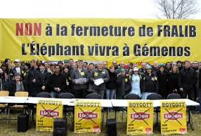
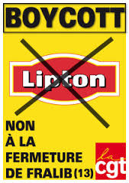
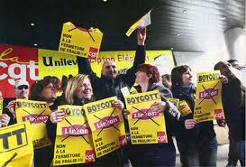
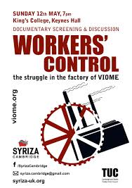
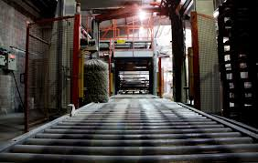
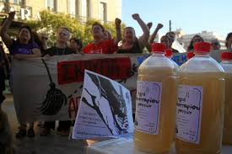
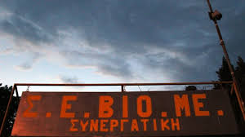
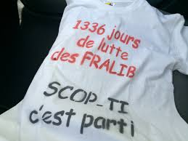
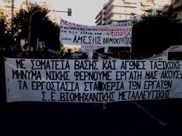

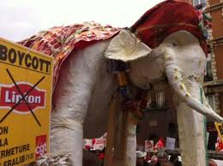
Thank you! ☺
Katerina Apostolidi
katerinapostolidi@ymail.com

