Slide 1
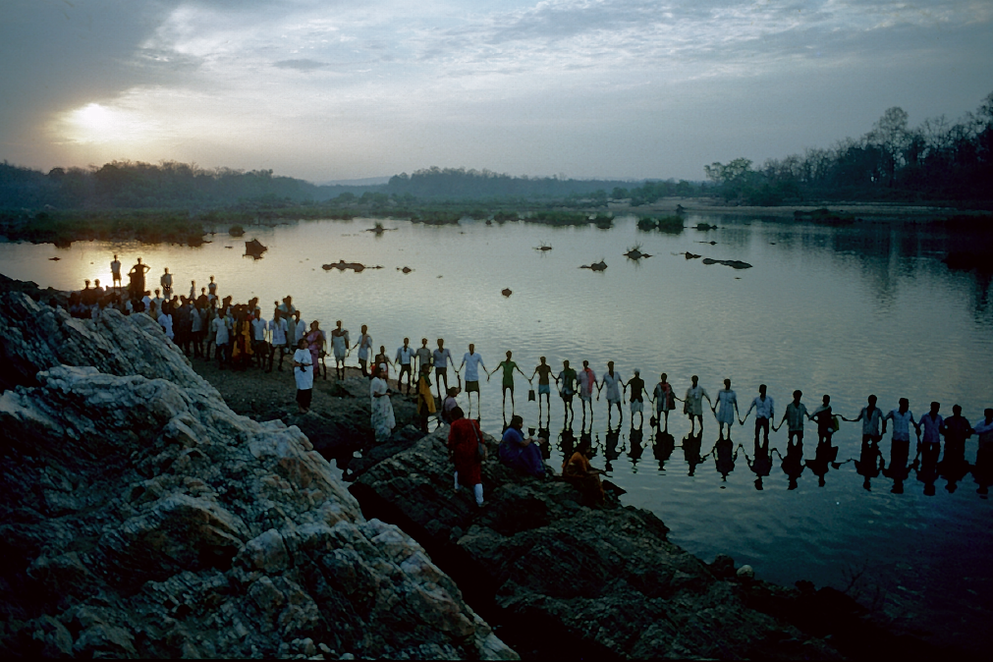
Radical Ecological Democracy and Degrowth
Towards a Sustainable and Equitable World

Slide 2
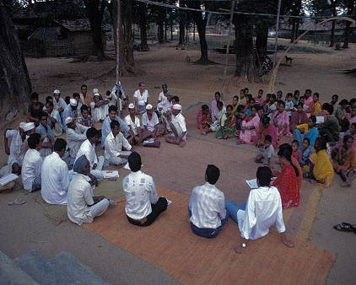
Lok swaraj (people’s self-rule)
“Our government in Mumbai and Delhi, we are the government in our village”
Notes:
2

Slide 3
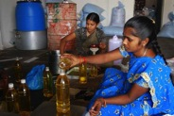
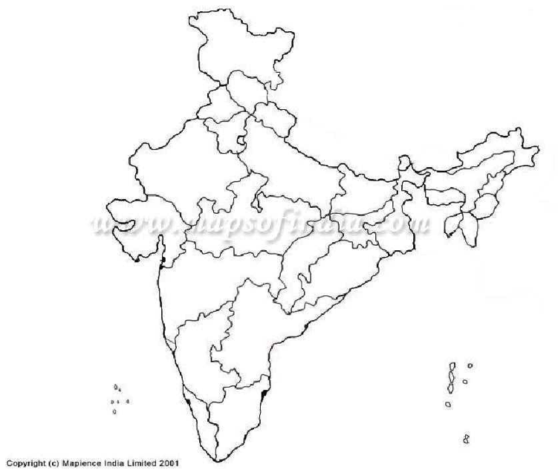
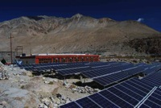
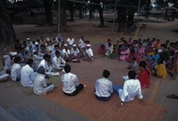
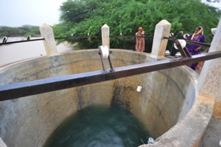
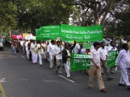
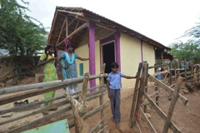

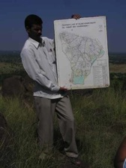
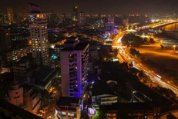
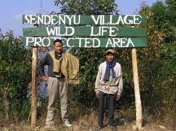
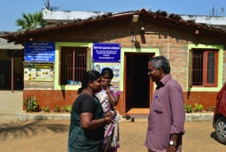
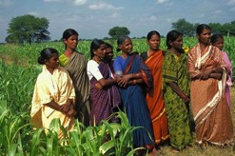
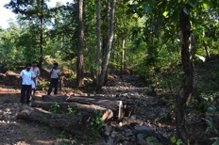
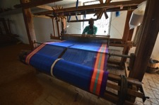
India: alternative initiatives for well-being
Energy
Food
Learning
Water
People power
Urban sustainability
Shelter
Crafts
Conservation
Livelihoods
Health
Village revitalisation
Producer companies

Slide 4
Eco-swaraj:
Radical ecological democracy
  (Radical = going to the roots, challenging the conventional)
achieving human well-being, through:
  empowering all citizens & communities to participate in decision-making
  ensuring socio-economic equity & justice
  respecting the limits of the earth
  Community (at various levels) as organising principle, vs. state or private corporation

Slide 5
Four key ingredients …
Direct & embedded political democracy
Economic democracy, self-sufficiency, localisation
Social justice & equity
Open, diverse knowledges and cultures
with Ecological base

Slide 6
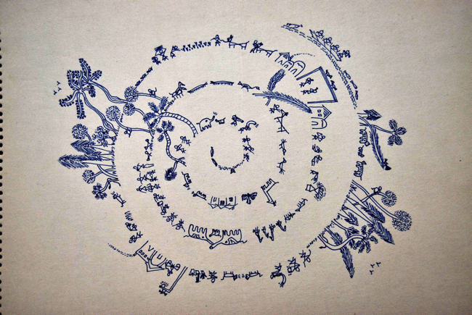
ECONOMICS OF PERMANENCE
Earthshastra: Economics as if the earth* mattered
* Of course, the earth includes people!
Notes:
6

Slide 7

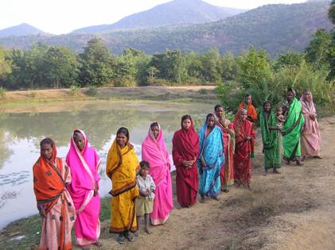
Values & principles….
Diversity and pluralism (of ideas, knowledge, ecologies, economies, polities, cultures…)
Self-reliance & autonomy
Cooperation, solidarity, the ‘commons’
Rights with responsibilities
Dignity of labour & subsistence
Qualitative pursuit of happiness
Justice
Simplicity, ‘enoughness’ (aparigraha)
Respect for all life forms
Notes:
7

Slide 8
Some issues facing Radical Ecological Democracy
Key agents of transformation?
Creating critical political mass out of scattered movements?
Nature of the State? Challenging the nation-state?
Local-to-global relations and governance?
Individual and collective: how to manage the creative tension?

Slide 9


Radical Ecological Democracy & Degrowth
Common values: sustainability, equity, justice
Both strive towards holistic transformation
Both require “cross-overs”
  Red & green (Ulrich Brand)
  Traditional & modern
  Indigenous & others
  Global north & south
  Reason & spirituality

Slide 10
Radical Ecological Democracy & Degrowth
But in global south …
Reality of large-scale deprivation; degrowth will not resonate
Needs own vocabularies, broadly in frame of a-growth* or post-growth … diversity of approaches and terms
* Latouche

Slide 11
Challenges …
Difficulties of cross-cultural exchange: worldviews, languages, concepts of time
Inadvertant power heirarchies: language, resources, communication technologies
Nationalistic barriers
Temptations to ‘replicate’, universalise, rapidly spread good ‘models’

Slide 12
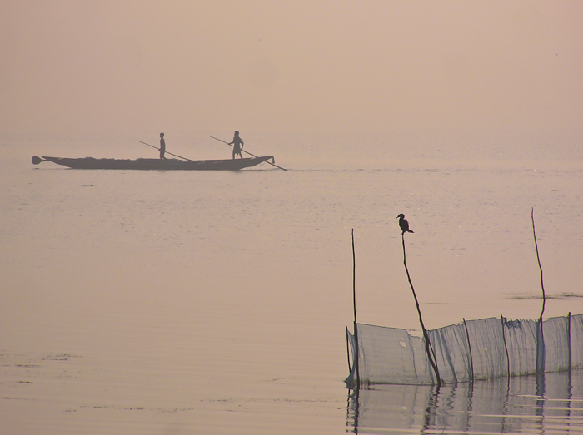
Towards cross-cultural learning and action on alternatives
Understanding of common values but diverse contexts, solutions, pathways, terms
Learning from each others’ innovations, methods, pathways
Joint exploration of equitable global relations … free exchange of cultures, ideas, knowledge, materials, and people …. reducing global north’s impact on global south
Joint exploration of global governance centred on peoples rather than nation-states
Notes:
12

Slide 13


For more information….
http://radicalecologicaldemocracy.wordpress.com
www.alternativesindia.org
Email: chikikothari@gmail.com

