Slide 1
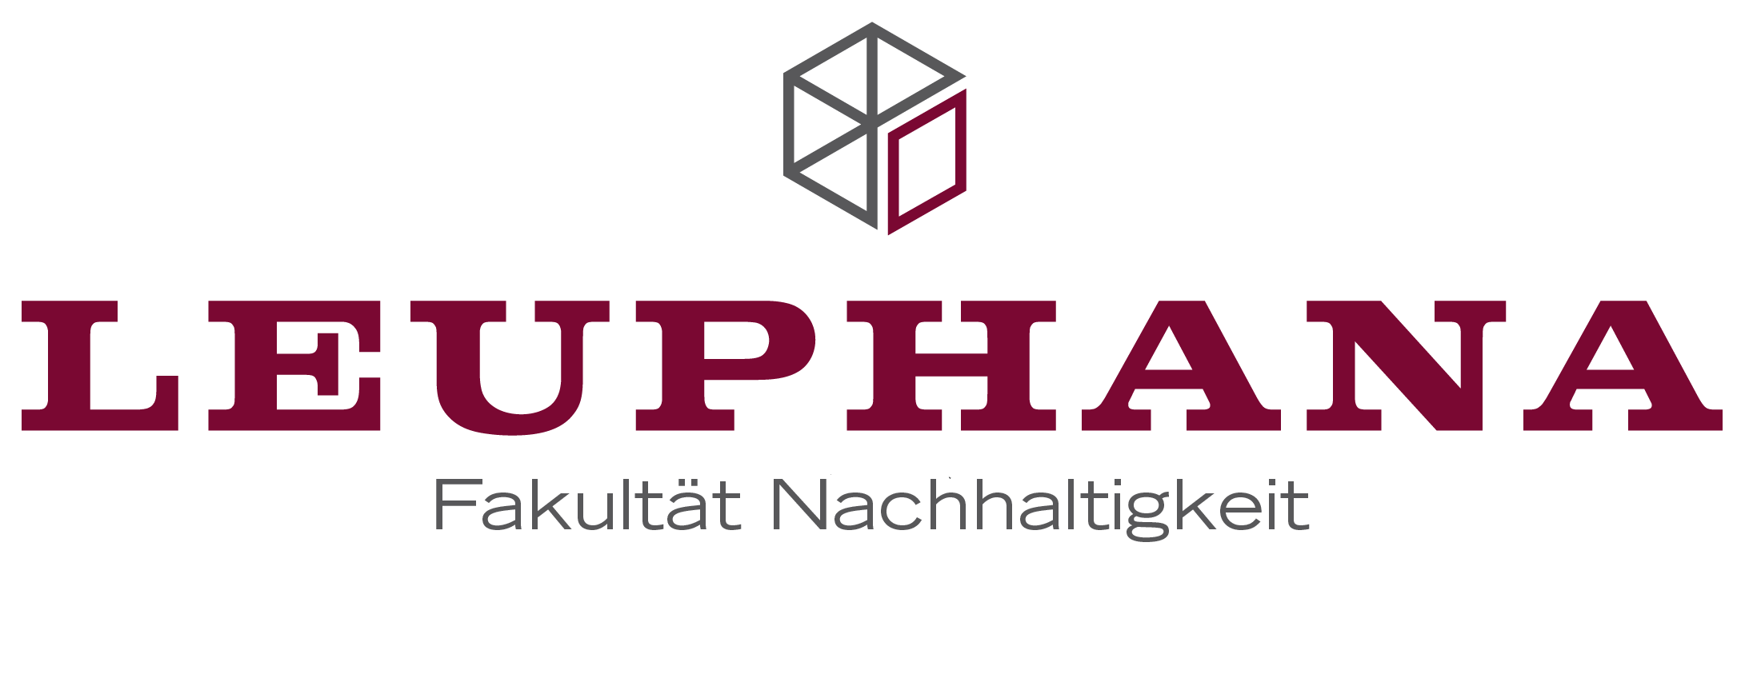
State- prescribed (re)productivity?
The Philippine Legislation on the Rights of Indigenous Peoples
Janina Dannenberg, M.Sc.
Leuphana Universität Lüneburg
Faculty of Sustainability
Scharnhorststraße 1
21335 Lüneburg, Germany
Janina.Dannenberg@leuphana.de

Slide 2
Important
Vision of the law: (Re)Productivity for Indigenous Peoples
Problem: (Re)Productivity only for the “traditional”; the “modern” stay capitalistic
Consequence: Inclusion/ Exclusion of Indigenous Peoples based on the demand of the capitalist economy

Slide 3
Outline
(Re)productivity: The basics
(Re)Productivity and the Indigenous Peoples Rights Act
“Modern” vs. “traditional” as a crucial dichotomisation and its consequences

Slide 4
Integrations within the concept of (re)productivity
Productive- Reproductive
Privat- public
Nature - culture
Conservation- exploitation or usage of nature

Slide 5
Outline
(Re)productivity: The basics
(Re)Productivity and the Indigenous Peoples Rights Act
“Modern” vs. ”traditional” as a crucial dichotomisation and its consequences

Slide 6
“SECTION 5. Indigenous Concept of Ownership. — Indigenous concept of ownership sustains the view that ancestral domains and all resources found therein shall serve as the material bases of their cultural integrity. The indigenous concept of ownership generally holds that ancestral domains are the ICC’s/IP’s private but community property which belongs to all generations and therefore cannot be sold, disposed or destroyed. It likewise covers sustainable traditional resource rights.“

Slide 7
“SECTION 5. Indigenous Concept of Ownership. — Indigenous concept of ownership sustains the view that ancestral domains and all resources found therein shall serve as the material bases of their cultural integrity. The indigenous concept of ownership generally holds that ancestral domains are the ICC’s/IP’s private but community property which belongs to all generations and therefore cannot be sold, disposed or destroyed. It likewise covers sustainable traditional resource rights.“

Slide 8
“SECTION 5. Indigenous Concept of Ownership. — Indigenous concept of ownership sustains the view that ancestral domains and all resources found therein shall serve as the material bases of their cultural integrity. The indigenous concept of ownership generally holds that ancestral domains are the ICC’s/IP’s private but community property which belongs to all generations and therefore cannot be sold, disposed or destroyed. It likewise covers sustainable traditional resource rights.“

Slide 9
“SECTION 5. Indigenous Concept of Ownership. — Indigenous concept of ownership sustains the view that ancestral domains and all resources found therein shall serve as the material bases of their cultural integrity. The indigenous concept of ownership generally holds that ancestral domains are the ICC’s/IP’s private but community property which belongs to all generations and therefore cannot be sold, disposed or destroyed. It likewise covers sustainable traditional resource rights.“

Slide 10
Integrations within the Indigenous Peoples Rights Act
Privat- public
Nature - culture
Conservation- exploitation or usage of nature
Materiality- spirituality
Owning- leasing

Slide 11
The Indigenous Peoples Right Acts is a law for those who are “identified by self-ascription and ascription by others” (sec.3) as Indigenous Peoples or Indigenous Cultural Communities.

Slide 12
Outline
(Re)productivity: The basics
(Re)Productivity and the Indigenous Peoples Rights Act
“Modern” vs. “traditional” as a crucial dichotomisation and its consequences

Slide 13
Important
Vision of the law: (Re)Productivity for Indigenous Peoples
Problem: (Re)Productivity only for the “traditional”; the “modern” stay capitalistic
Consequence: Inclusion/ Exclusion of Indigenous Peoples based on the demand of the capitalist economy
Thank you very much!

