Slide 1
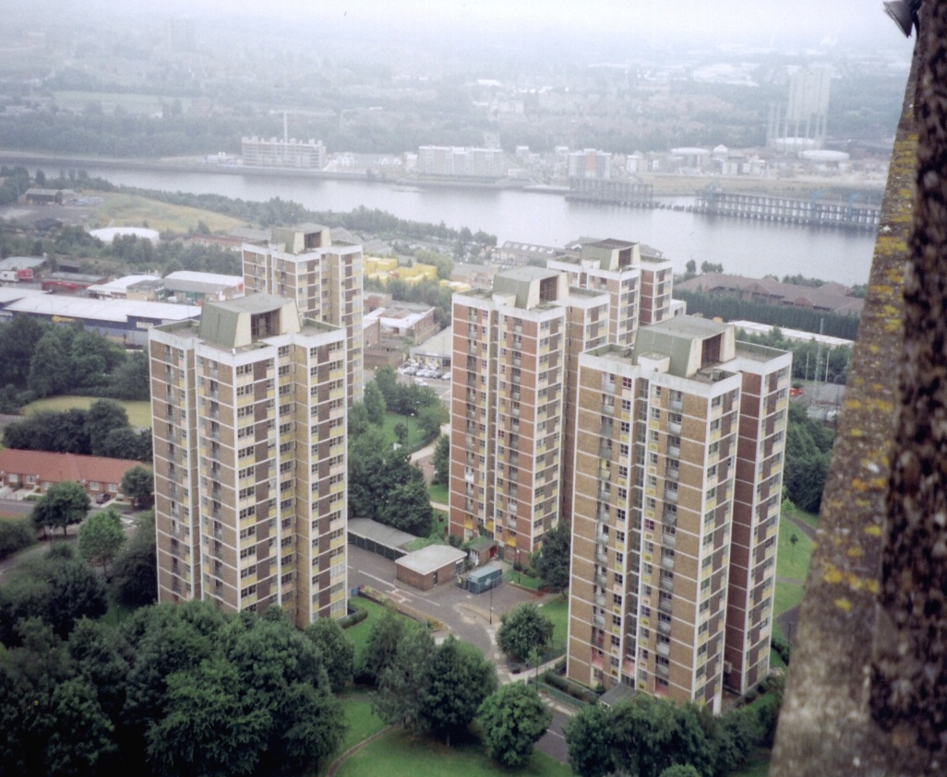
Roles for university researchers in promoting sustainability
Audley Genus
Kingston University

Slide 2
Significance
The contribution of higher education institutions and researchers
Developments at the international level (e.g. at the United Nations)
Concern about relationship between academic research and lay knowledge, the legitimacy and credibility of science, and governance of science, technology and environmental issues
Notes:
United Nations’ Decade of Education for Sustainable Development) (United Nations General Assembly, 2005), the Talloires Declaration (2005), and Chapter 31 of the Agenda 21 document from the Earth Summit held at Rio (United Nations Sustainable Development,1992
Gibbons, 2000; Gibbons et al 1994; Jasanoff, 2003a; 2003b; Nowotny et al, 2001 – MODE 2

Slide 3
Significance
Background: significance of local action to low carbon agenda and policy objectives
Recent legislation and initiatives: NESTA’s Big Green Challenge, DECC LCCC
Academic literature: e.g. Bull et al, 2008; Nye & Burgess, 2008; Walker et al, 2007; Seyfang & Smith, 2007
Neglects critical discursive analysis of constitution of relations and action

Slide 4
Literature
Contributions at regional and city levels
Not as much at sub-city scale
Invoke richly descriptive network analysis
(not used as ‘neutral’ scientific method but
to facilitate reflection on a single case)

Slide 5
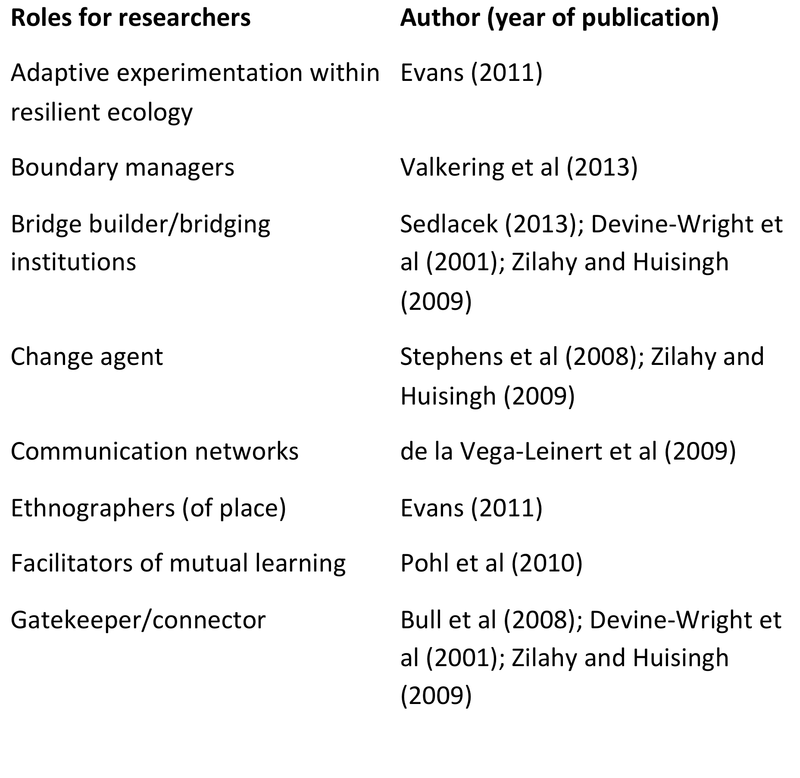

Slide 7
Newcastle Low Carbon Neighbourhoods project
Research questions underpinning the project: (1). what roles do university researchers play in sub-city scale sustainability initiatives? and (2). what structural and other factors affect the capacity of academic researchers to play such roles?
(3). What related discursive domains, themes and story sets may be identified?
Focus on period 2007-11

Slide 8
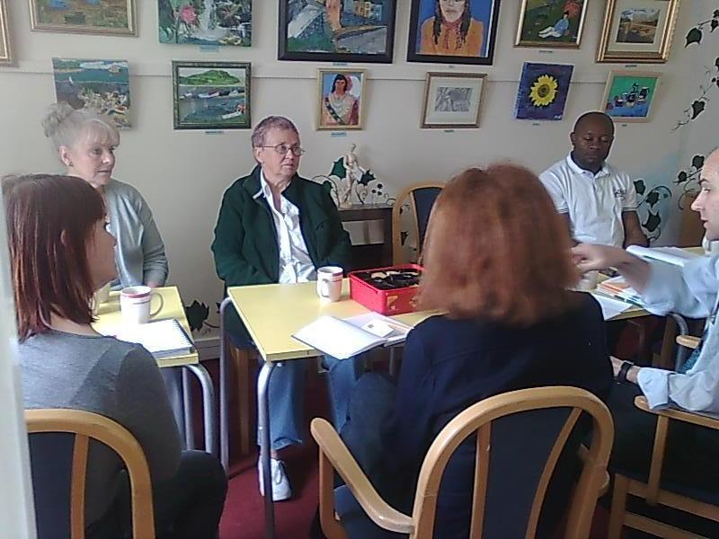
Description of project context
Newcastle Low Carbon Neighbourhoods
Multi-actor, 4 year research/engagement
Disparate funding/support: RCUK/ New Deal for Communities/ local HEIs/ Newcastle City Council
Multi-disciplinary; inter-university

Slide 9
Researchers’ roles in the NLCN project
consultants
intellectual authorities
action researchers
facilitators of interactive research

Slide 10
Institutional environment
requirements for securing national research funding for individual projects or centres,
criteria for assessing the quality of research

Slide 11
Structural factors
project-specific funding and support – roles (?)
density of the project network
the reciprocity of ties among the participants
the confluence of interests among some contacts and members of the research team

Slide 12
Non-structural factors
personal, pre-existing involvement of one of the research team in local ‘green’ groups
helped to build credibility with some participants
Similarity of interests/working practice c.f.
r/ship of researchers with tenants and activist housing cooperation. Network elite?

Slide 13
Domains and Story Sets
Domains | Associated story sets | Example contacts | Discursive texts/practices
Low carbon energy research | Interdiscipli-narity; mode 2; funding proposals | Beacon NE, NEFCC, EST, NEA | Funding calls and applications prepared; SCRI, NEFCC, Carbon Routemap events
Engagement | Co-inquiry; action research; 'impact' | Beacon NE, NCCPE, ICE | Workshops; training events; website materials; proposals

Slide 14
Domain | Associated story sets | Example contacts | Discursive texts/ practices
Regional development (North East of England) | Urban regeneration community cohesion | Science City; City Council; One North East | Scientia ’08; annual reviews, meetings/ email/calls
Fuel poverty reduction | Lower energy bills; social justice | NDC; Tenants associations X and Y | Workshop flyers; Eco-neighbour-hood plans

Slide 15
Domain | Associated story sets | Example contacts | Discursive texts/ practices
Low carbon building | (Eco) retrofitting; RETs | YHN, Private Rented Ser-vice | eco-house tour; Cruddas Park visit
Grassroots movements | active citizens | Co-op; tenants assocs; TIN, | Meetings; leaflets; plans; public events
Social enterprise | Emerging business models; ESCOs | CoRE, Newcastle Science Co. | ‘RAKE' bid; CoRE training (AG)

Slide 16
Domains | Associated story sets | Example contacts | Discursive processes: texts/practices
Sustainable communities | CO2 targets; new business sectors; ‘green localism’ | DECC; Local councils, Bridging NG; David Gershon | Gershon meetings; Draft sustainable communities strategy; super output maps

Slide 17
Conclusions
Degrowth themes (reducing energy consumption)
Transforming education?
New patterns of interaction?
Inclusivity and fairness?
Community action and city development

Slide 18
Conclusions
Difficulty of realising and maintaining process and substantive outcomes
Impact of unforeseen (positive and negative) changes! (e.g. NCCPE, CAR; LA funding cuts)
Time and resource-hungry research activity
Demands on training/support of researchers and community participants

Slide 19
Conclusions
Tension between discursive domains
Discourses exclude and include
Awareness-raising and reinforcement
But: little evidence of sustained impact

Slide 20
Conclusions
Academic researchers play multiple, sometimes conflicting roles
national structural and locally contingent factors affect collaboration and durability
more conventional projects may avoid some difficulties, but lose in richness and originality.

Slide 21
THANK YOU
Email: a.genus@kingston.ac.uk

