Slide 1
Nina Horstmann
Crowdfunding: Democratising finance for the green economy

Slide 2
Myths and the Battle of Lines
Can the Big Six become the Big Sixty Thousand?
Virtuous bankers, flying pigs
Crowdfunding: Democratising finance for the green economy

Slide 3
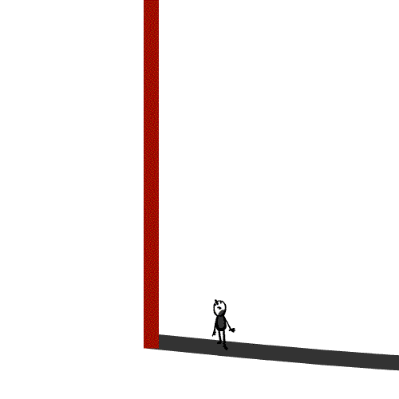
1. Financing of renewable energy
2. Alternative models to traditional banking systems
3. Crowdfunding for renewable energy and the
4. Motivations of the ‘green crowd’

Slide 4
VERTICAL LINES
Institutional, centralised growth driven hierarchies
HORIZONAL LINES Democratic, decentralised value driven connections

Slide 5
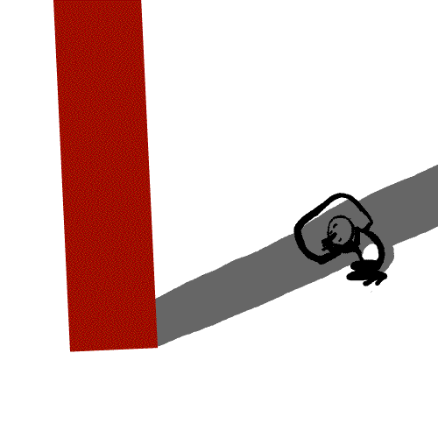
1. Financing of renewable energy
Crowdfunding connects directly people with money to the people who need it.

Slide 6
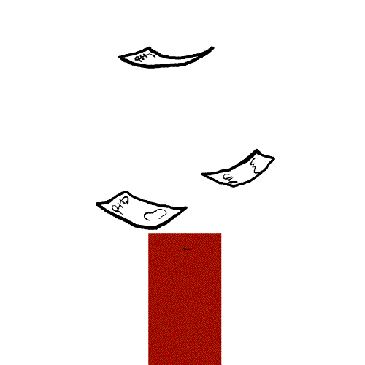
2. Alternative models to traditional banking systems
Crowdfunding turns an exclusive investment market into an inclusive one.

Slide 7
3. Crowdfunding for renewable energy
Crowdfunding turns an exclusive investment market to an inclusive one.

Slide 8
project's cause financial return support of renewable energy benefits for the communities democratic finance risk & portfolio considerations
ownership
transparent ethical investment
male
well-educated
local support of renewable energy projects
financial education
4. Motivations of the ‘green crowd’

Slide 9

Crowdfunding as an opportunity to bring change from a vertical power distribution to a horizontal one.

Slide 10
Thank you for your attention
Nina Horstmann nina.horstmann@bioregional.com www.bioregional.com
Illustrations ‘The Story of the Line’ by Matt Abiss & Charlotte Webster
http://blog.abundancegeneration.com

