Slide 1
SSE as a Transitional Path Towards a Degrowth Society
The case of the Geneva Canton
Mònica Serlavós
4th International Degrowth Conference, Leipzig, Germany
2-6 September 2014
Social & Solidarity Economy

Slide 2
Structure of the presentation
Why this topic?
Methodology
Degrowth
  What are we referring to by degrowth?
  Origins of the concept
Social and Solidarity Economy
  What is SSE?
  Where does it fit in the economy?
  Origins of the concept
  La Chambre d’économie sociale et solidaire de Genève (The Geneva SSE chamber)
Degrowth and SSE
  6 dimensions for comparison
  Survey design
  Results of the survey
Conclusions
Final comments and future research

Slide 3
Why this topic?
Development
Post-development
Degrowth
SSE
Multidimensional crisis (social, economic, environmental, cultural...)
Crisis defined as an opportunity, decision or choice (Greek: κρίσις ) and sieve (Indo-european: krei )
Paradox: impossibility for the degrowth paradigm to exist inside a capitalist / neoliberal system (irreconcilable break-up)
SSE as an hybrid model capable of adapting itself in a market economy while promoting an alternative societal model → TRANSITION! (understood as a slow maturation of a deep change)

Slide 4
Methodology
Triangular methodological design:
Case study: Geneva Canton
Lack of existing literature on the topic (threat and opportunity)
Need for further research
Literature Review
Observation
Individual interviews
Quantitative survey

Slide 5

What are we referring to by degrowth?
‘Downscaling of production and consumption in the industrialized states that increases human well-being and enhances ecological conditions and equity on the planet’
Definition provided by the organization of the 4th International Conference of Degrowth
Voluntary simplicity
Collective action
Political participation

Slide 6
Origins of the concept
19th century → anti-industrialism (Roskin, Tolstoï)
1970s → first theoretical basis
  Nicholas Georgescu Roegen (1971): ‘The entropy law and the economic process’
    Translation of the book – Jacques Grinevald
    Bioeconomy → ecological economy
  Ivan Illich (1973): ‘Tools for conviviality’
  E.F. Schumacher (1973): ‘Small is beautiful’
2000s → revival of the topic
  Serge Latouche, International Conferences, ...

Slide 7
What is SSE?
Social Economy (internal organization)
Solidarity Economy (public utility)
Social and Solidarity Economy
5 criteria (Lipietz):
1. Freedom to adhere
2. Non-lucrativity
3. Democratic management
4. Collective or social utility
5. Hybridisation of resources

Slide 8
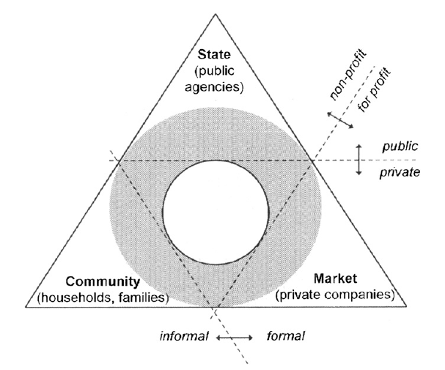
Where does it fit in the economy?

Slide 9





Origins of the concept
19th century → ‘Social Question’
1970s → increase of associations and foundations (self-managed)
From 1980s – 1990s→ resilient model in a context of crisis
  Europe = 6.5% paid employment (UNRISD, conference May 2013)
  Switzerland = 10% of paid employment (Pellet, Thierry et al, 2010)
Currently → increasingly visible (WSF, RIPESS, EMES, UNRISD, ILO…)

Slide 10

2004 (WSF)
‘Non profit association working for the promotion and recognition of SSE in the Geneva region’
Values:
  Social well-being
  Participative approach
  Respect of the environment
  Autonomy
  Solidarity
  Diversity
  Coherence
Charte de l’économie sociale et solidaire de la région genevoise (2005) – SSE Charter of the Geneva region

Slide 11
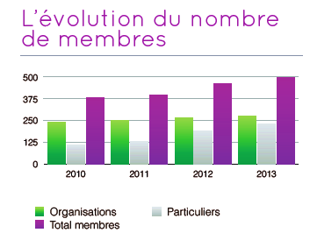
‘Evolution of the amount of members’, Activity Report 2013, APRES-GE

Slide 12
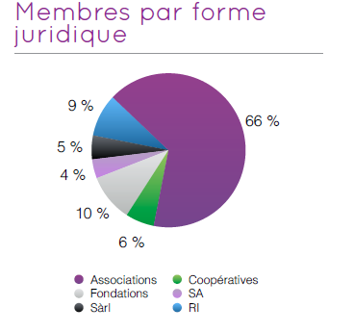
‘Members by legal status’, Activity Report 2013, APRES-GE

Slide 13
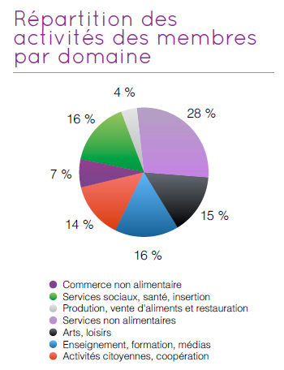
‘Sector of activity of members’, Activity Report 2013, APRES-GE

Slide 14
Degrowth and SSE
The 4 scenarios of Laurent Fraisse on the role of SSE as an alternative in a globalised world:
Social-liberal
Recognize the existence of social enterprises in the market
Democratization of the economy
Plural economy
Post-capitalist
SSE as a basis for an alternative economy
Post-development
SSE as a path towards a sustainable degrowth

Slide 15
6 dimensions for comparison
Lucrativity
Relocalization
Environment
Collective interest
Relation to work
Democracy
Degrowth bullet points (ICD, BCN 2010)
Membership criteria of APRES-GE (2011)
CONVERGENCE!
Divergence of values and analytical limits:
Degrowth (vision) | SSE (mean)
Anti-capitalist | A-capitalist
Radical change | Progressive transition (debate)

Slide 16
Survey design
Theoretical dimensions | Survey dimensions
Environnement | Ecology
Re-localization | Territory
Relation to work | Organisation
Democracy
Collective interest | -
Lucrativity | -
- | Production
6 to 4 dimensions: Lucrativity and collective interest – too large, statistical survey on SSE 2010, required criteria to be a member
Aim: analyse the behaviour of the actors in the field (Geneva) with regard to the four analytical dimensions defined
Target: all the members of the APRES-GE (265)
Limits of the research: email, rate of response (17% of the total), lack of literature in constructing the dimensions, very concrete questions, extrapolation of the results, large variety of definitions

Slide 17
Results of the survey
Ecology
Lack of information (CO2, ecological footprint)
Territory
Organization
Production
Wide range of answers : 1 participant haven’t heard about degrowth. Emphasis: ecological dimension, well-being
Limitations for small structures (social vs. Environmental)
Slow (51%), short (31%) and semi-fast (18%) consumption goods
75% of supply, 81% of demand → < 80km (French law)
97.67% SME (micro-entreprises, <9)
48% of participants work between 50%-90%, 42% of participants work at 50% or less, 6% work full time
91% say to respect democratic internal rules
Limited relevance of the question (services vs. Products)

Slide 18
Conclusions
Initial hypothesis: SSE as a transitional path towards a degrowth society
Context: limits of the current development model
Degrowth as a potential future scenario
SSE as a hybrid model capable of adapting in the present economic and social structure (innovative definition APRES-GE)
Convergence and coherence between SSE and degrowth in all the identified dimensions (theoretical and empirical level)
Despite the limited and provisional nature of our research we accept our hypothesis:
Need to create synergies and links between the SSE actors
SSE can offer a transitional path towards a degrowth society

Slide 19
Final Comments & Future Research
Final Comments:
  Key role of other actors (public sector, private sector...)
  The social transition will be planned or will be the result of the pedagogy of catastrophes?
  This will depend on the capacity of SSE to adapt itself to the current context while going on promoting alternative values
Future research
  Focus on degrowth organizations
  Analysis of the coherence between work and personal lifestyle
  Comparative study of definitions and approaches of SSE from a degrowth lens
  Enlarge the study to other geographical areas

Slide 20
‘A elle seule, elle ne pourra pas régler toutes les questions centrales qui se posent à l’humanité, c’est certain, mais sans doute est-elle en mesure d’apporter sa pierre à l’édifice d’une économie au service des hommes et non au service de la financiarisation du monde’
~
‘By itself, (SSE) won’t be able to fix all the challenges faced by humanity, that’s for sure, but it will undoubtedly contribute to build an economy in the service of people rather than in the service of the world financiarisation’
Thierry Jeantet (2008): ‘L’économie sociale, une alternative au capitalisme’

Slide 21

Questions and remarks...?
THANK YOU!

