Slide 1
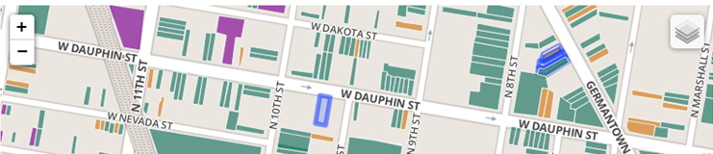
Grassroots digital commons for a bottom-up transition towards (urban) sustainability
Adrien Labaeye
PhD student, Humboldt University in Berlin
Co-founder, transition>>lab

Slide 2
Content
Information & urban sustainability
The commons approach
Social and grassroots innovation
Explorative cases
Discussion
Conclusion

Slide 3
Information and (urban) sustainability
Smart cities to deliver sustainability? (Toppeta 2010)
Smart cities approach biased towards (Kramers et al. 2013):
  Business: IBM, Cisco, Schneider Electric, Siemens, etc.
  Local governments
The urban governance of information
  Information is a resource: “Information is the new oil”
  Information governance is a battlefield of environmental governance (Mol 2008): power and politics
  The centrality of cities:
    Flows of information, ecological footprint, risks, innovation
Notes:
In smart cities approach, information seems to be a neutral object that just need to be better managed!

Slide 4
The commons approach
Data/information/knowledge as a commons (Hess & Ostrom 2007)
Commons = resource shared by a group of people and vulnerable to social dilemmas (Ostrom)
  Enclosure, pollution, overuse, commodification
Commons (resource), commoning (practice), commoners (users)
Looking beyond market and state: self-organized commons (Ostrom 1990)

Slide 5
Social & grassroots innovation
Transition theory: from niches to mainstream
  Niches are protected spaces where learning, experiments, radical innovation happen (Geels 2004)
Moving the focus from technologies towards social and institutional arrangements
  Strategic niche management and social innovation (Witkamp et al. 2011): eg. Social business
  Grassroots innovation (Seyfang & Smith 2007; Seyfang & Haxeltine 2012; Seyfang et al. 2014): eg. TT, community energy, local currencies

Slide 6
Questions?
How are grassroots/bottom-up information resources self-organized (ie. Outside the market and state)
What are the outcomes of such self-organized information resources?
What are the implications of these self-organized information resources (digital commons) for the degrowth approach?

Slide 7
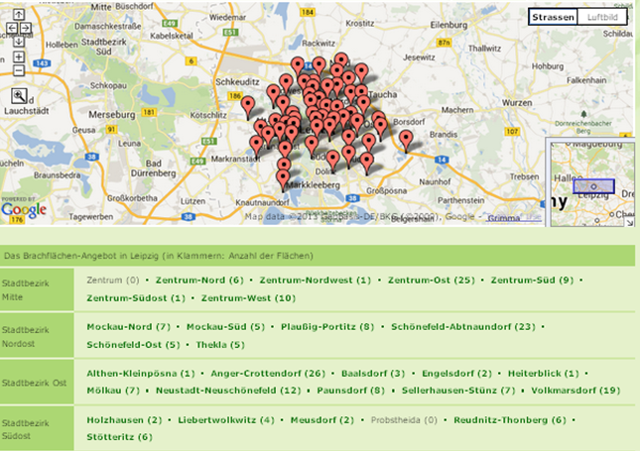
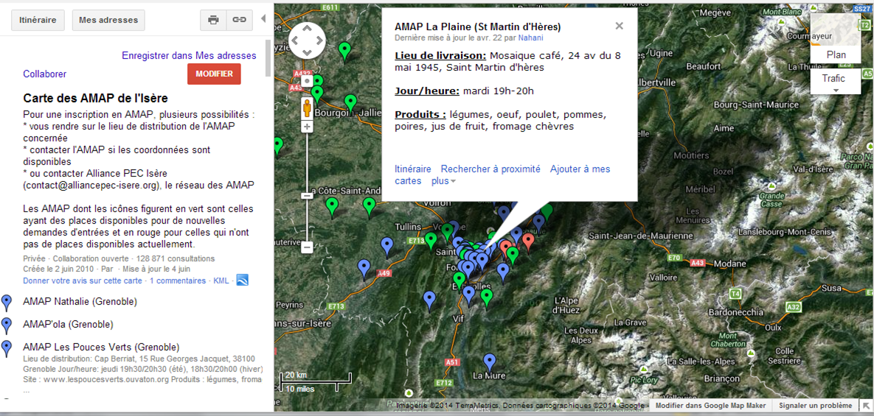
Explorative cases
http://flaechen-in-leipzig.de
  Community gardening in Leipzig, Germany
  Public data managed by civil society and grassroots
  Local community
  Online and offline interaction
Map of community supported agriculture initiatives (FR)
  Bringing consumers to local farmers
  Map: grassroots data/information (collaborative)
  Trans-local community
  Online and offline interaction

Slide 8
Discussion
http://groundedinphilly.org
  Local transition in the management and use of information with potential important impact on governance of land use
  Niches: replication & learning from NYC to Ph., vision: making vacant space available to communities, building local network, empowering through open source code…
  Outcomes/interactions: Quality of data (up-date)? Sustainability of initiative? Digital divide? Conflict?
Map of bike co-ops
  Emergence of self-organized information resource
  Niches: Crowdsourced, no licensing (no protection), increase visibility and identity of grassroots innovation niche (?), building a network/community,
  Outcomes/interaction: real use of map and influence of map? Sustainability of initiative?
http://flaechen-in-leipzig.de
  Local transition in the management and use of information with potential important impact on governance of land use
  Outcomes/interactions: Quality of data (up-date)? Sustainability of initiative? Digital divide? Conflict?
  Local niche: supports replication of community gardens? Common vision: making vacant space available to communities, building local network
Map of CSA in Rhônes-Alpes, France
  Emergence of self-organized information resource
  Outcomes/interaction: over 120,000 views for Isère map since 2010, fragmentation of maps (innefficient), collaborativeness ensures sustainability
  Niche: increase visibility and accessibility of grassroots innovation niche (empowering/enabling), building a network/community, support for translation to mainstream?

Slide 9
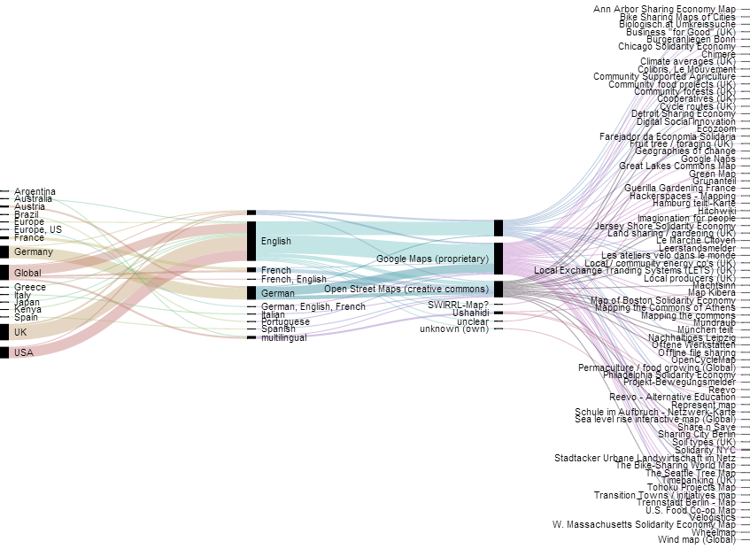
#14MMM mapping of the mappings
  → Collaborative, sharing, solidarity economy, commons, CSA, urban gardening, DIY, DIT, hacker spaces/FabLab, fruit picking, etc.
Data from http://14mmm.org

Slide 10
Conclusion
Actors (commoners) involved:
  ‘traditional’ local grassroots groups, civil society organizations but also native online collaboration (developers, mappers…) → commons-based peer production
Outcomes? Efficiency, equity, sustainability
  Availability is not access: problem of digital divide
Grassroots digital commons:
  Enable networking, replication, diffusion of social innovations/grassroots practices without market or state support
  Open up new horizons in research methods for mapping and data collection: action research?
Commons approach changes focus:
  From technology + businesses + financial capital + gov intervention (eg. subisidies)
  Towards shared resource+ collective action + social capital + self-governance mechanisms (eg. CC licenses)

Slide 11
Thank you!
Adrienlabaeye@gmail.com
@alabaeye
transitionlab.de
14mmm.org (mapping alternatives)

